Slide 1
FAIR @ ESRF
5th November, 2019
Author: Andy Götz

Slide 2
News on FAIR @ ESRF in 2019
Example of a young scientist doing Open Science
Planning for implementation of Data Policy
Metadata definitions
Data repository certification
E-Logbook ready
Long term archiving plans
Other news

Slide 3
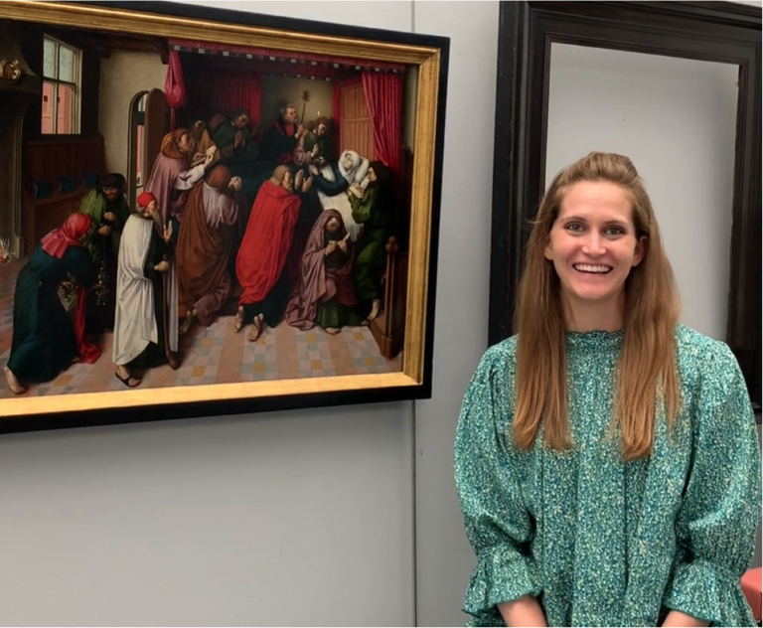
Example of Open Science
This repository is a companion to the following paper: “Sulfur K-edge Micro- and Full-field XANES Identifies Marker for Preparation Method of Ultramarine Pigment from Lapis Lazuli in Historical Paints” by Alessa A. Gambardella et. al.
The aim of this repository is to allow reproducibility of the processed results presented in the publication from experimentally obtained raw data. The intention is that the presented research is fully reproducible. Efforts have been made to the best of the authors' abilities to make the data -- and associated processing procedures -- 'FAIR' (i.e. findable, accessible, interoperable, and reusable) in support of the growing Open Science movement.
All of the figures in the paper corresponding to XANES data (unfocussed, microbeam, and full-field) can be reproduced herein following the set of notebooks contained …
https://github.com/alessaan/rhapsody-in-blue

Slide 4
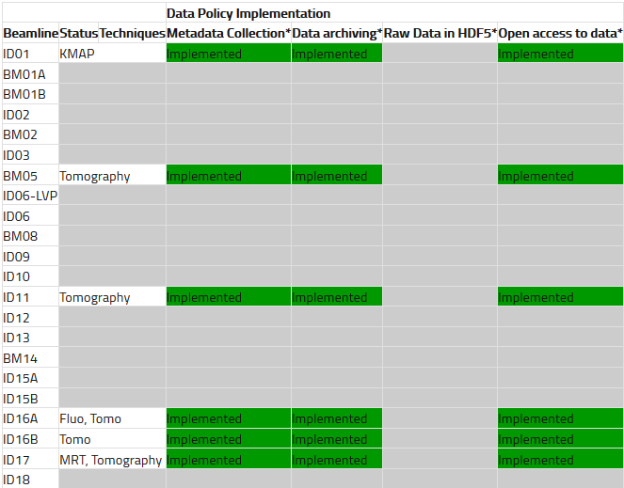
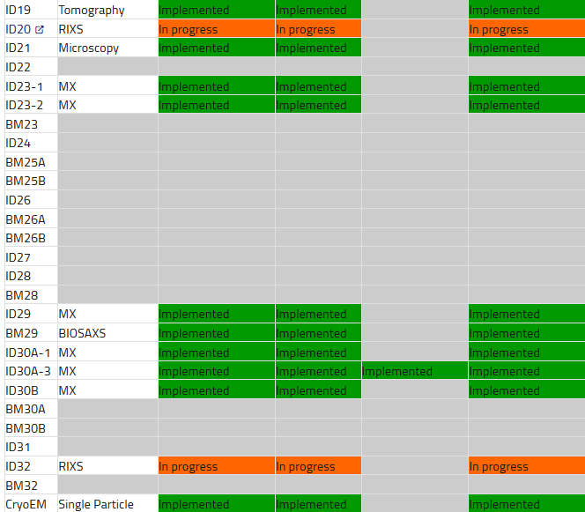
Planning for implementation of Data Policy @ ESRF
Current implementation is on 50% of beamlines, 100% in 2020

Slide 5
FAIR @ ESRF metrics on 5/11/2019
541 226 Datasets curated until now
9 experiments currently have Open Data
110 Datasets are Open Data
11 experiments will be released from embargo in 2020
510 experiments will be released from embargo in 2021
500+ “standard” metadata items defined so far

Slide 6
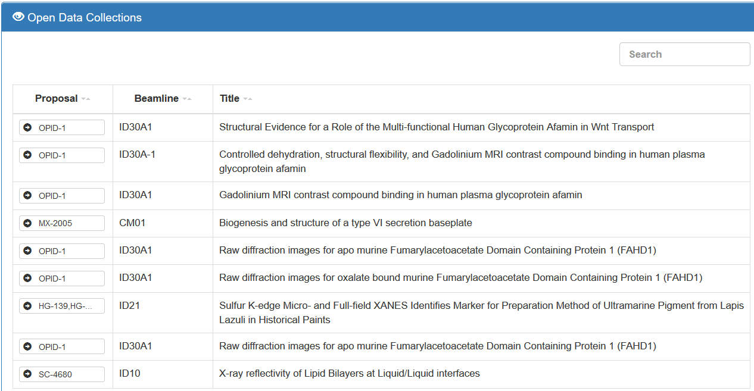

Slide 7
Data repository
ESRF Data repository has been selected by FAIRsFAIR to be certified
New developments on https://data.esrf.fr
Improved UI
Added Elasticsearch search mechanism
Support ingesting supporting material + pre-DP experiments

Slide 8
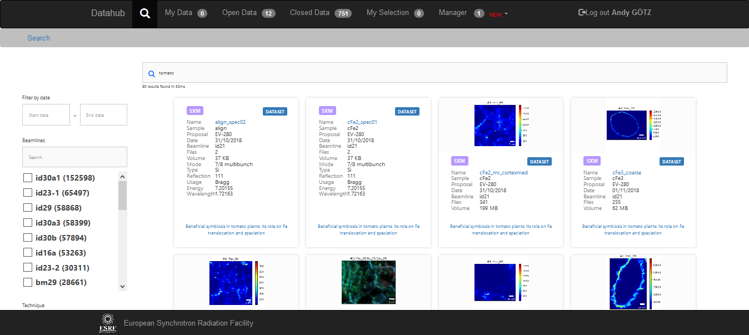
Data repository

Slide 9
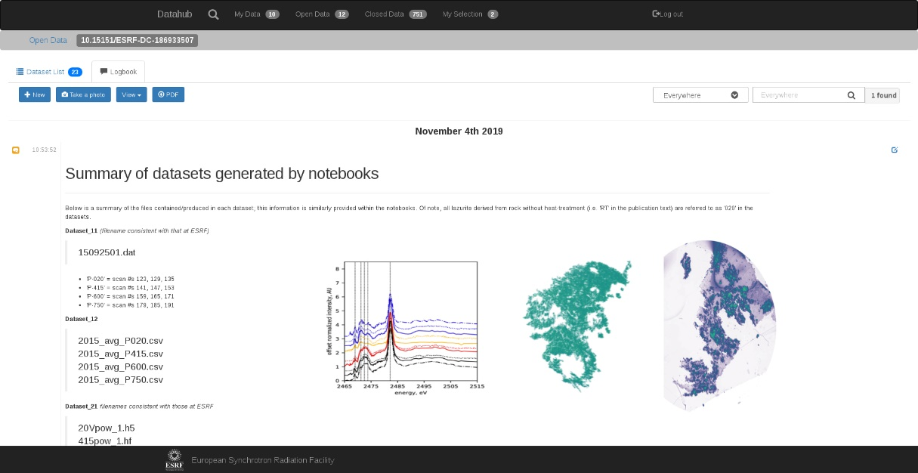
E-Logbook ready
A rich electronic logbook has been developed @ ESRF
Open Source - https://gitlab.esrf.fr/icat/elogbook-standalone
Try it! (XFEL plans to try it)
Tested on 3 beamlines in 2018
Rollout on all beamlines in 2020
Next step is to add extra support for sample metadata

Slide 10
E-Logbook ready

Slide 11
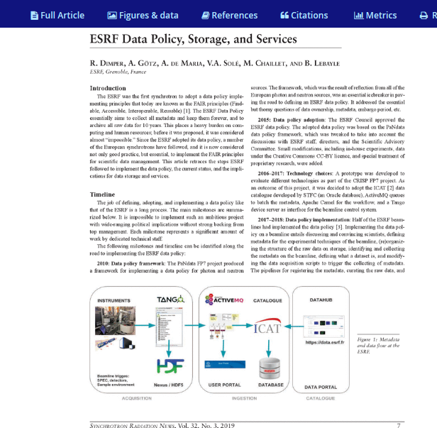

Article on Implementation of ESRF Data Policy
https://doi.org/10.1080/08940886.2019.1608119
Published online: 23 May 201

Slide 12
Long term archiving plans @ ESRF
Current situation: raw data are backed up daily + archived long term
Not scalable to Petabytes of data being produced
Decision to drop daily backups of raw data and only do long term archive
This requires ALL raw data to be correctly curated and managed
Starting in September 2020

Slide 13
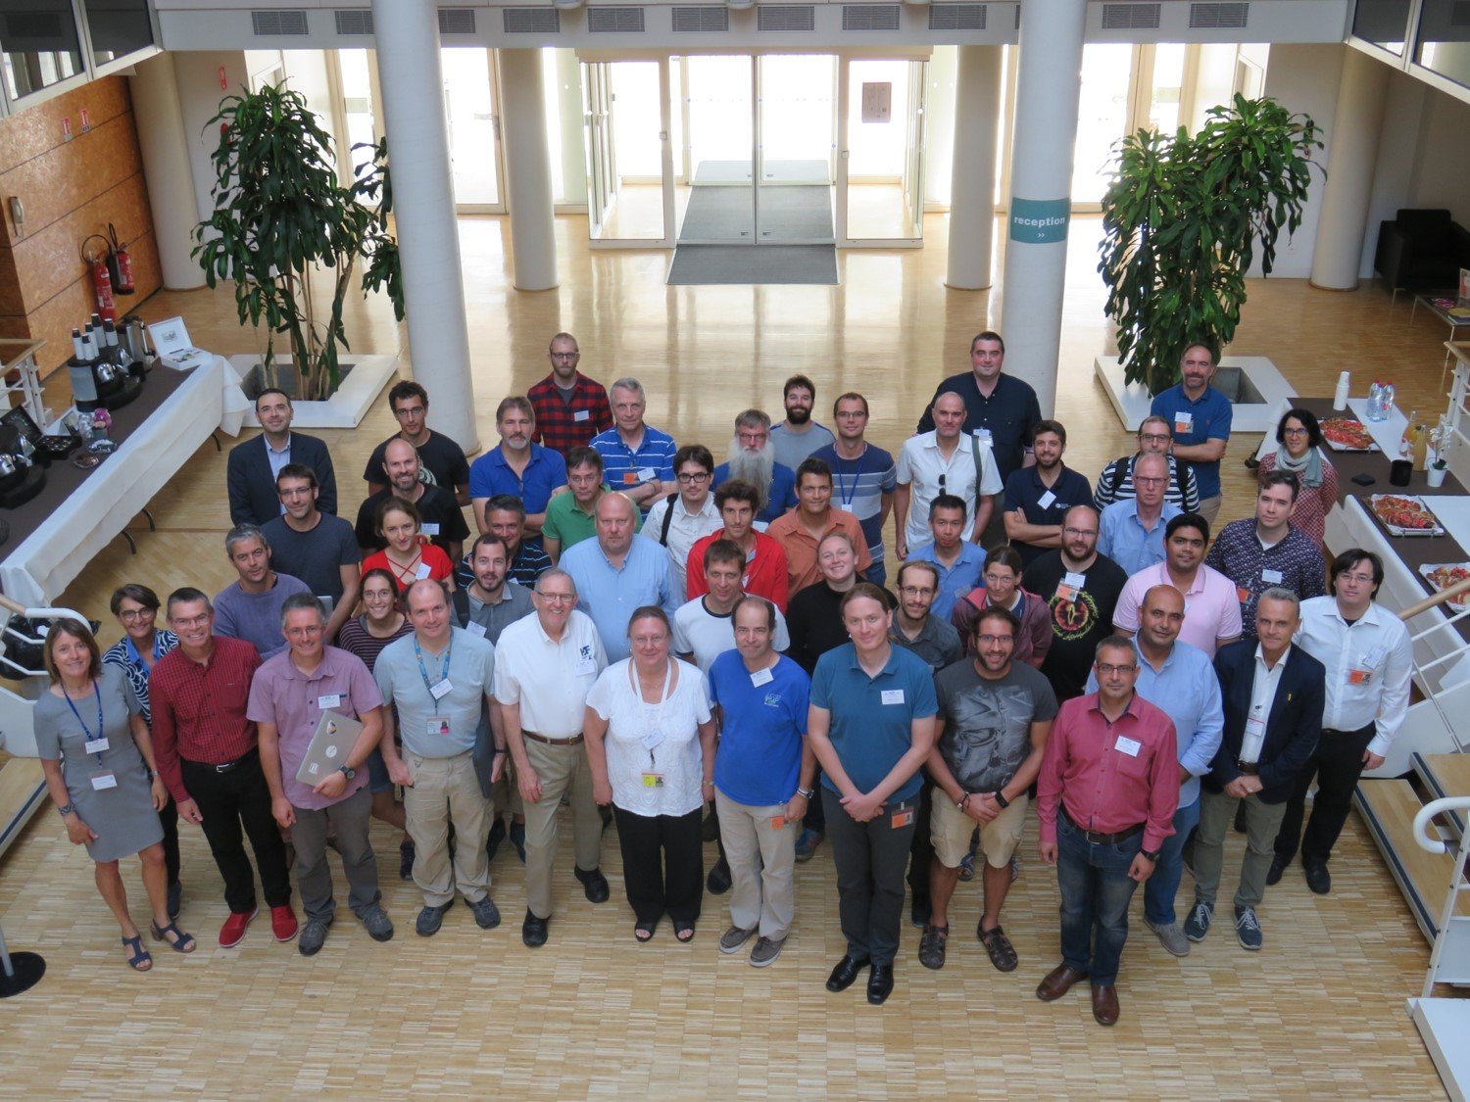
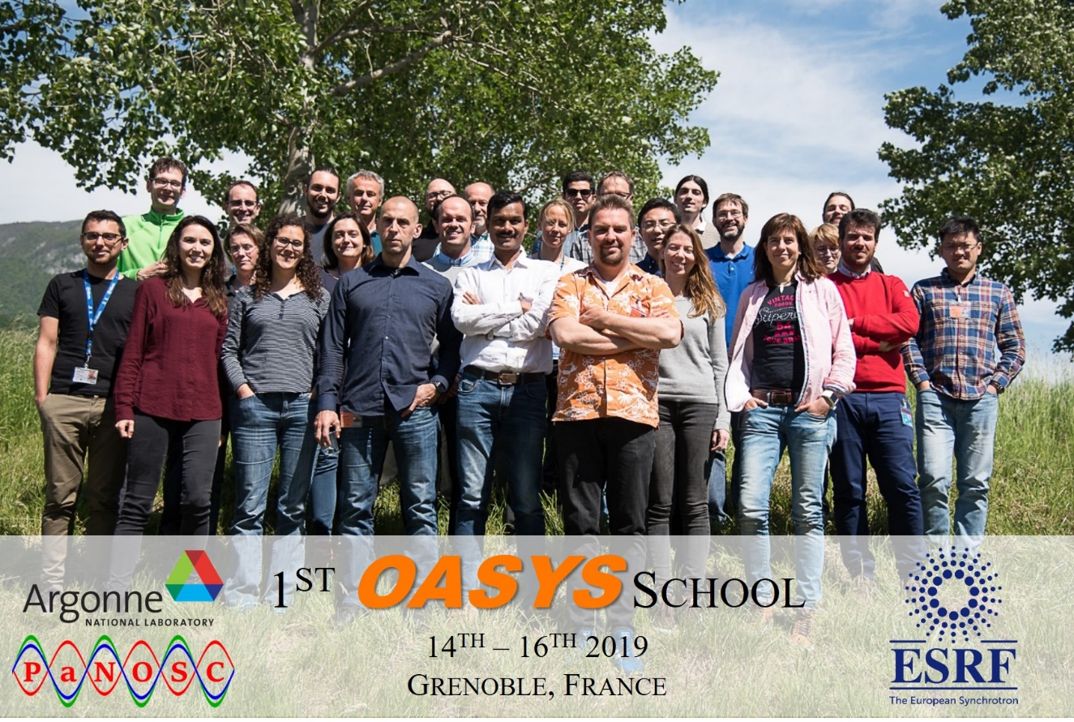
PaNOSC (partially) sponsored workshops
OASYS school for photon beamlines
HDF5 workshop

Slide 14
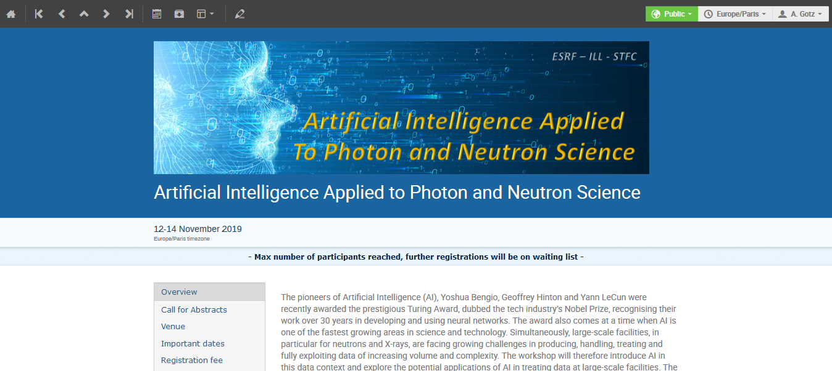
Workshop on AI + ML in Photon and Neutron Science

Slide 15
Other news
Presented PaNOSC and all FAIR developments to ESRF staff
Adaptation of PUMA-BI from ILL to ESRF case
Deployment of globus-online for download soon (2019)
IBM Power 9 cluster with hardware compression + high bandwidth GPUS
2 new hires for PaNOSC this week, RD will be much more involved in PaNOSC from December 2019, 1 DevOps position still open
PaNOSC is financing the implementation of FAIR data @ ESRF

Slide 16
Thanks to Alex, Maxime, Armando, Rudolf, Alessia, Matthew, Isai for their help
andy.gotz@esrf.fr

